Slide 1
Hadoop Ecosystem - Kafka

Slide 2
Table of Contents
Hadoop Ecosystem
Development Background
Key Features & Benefits of Kafka
How Kafka Works?
Kafka Use Cases & Case Study – Netflix Architecture
Study Comments – Compare with RabbitMQ
Summary
References
Notes:
https://www.meritdata-tech.com/resources/blog/digital-engineering-solutions/netflix-apache-kafka-business-intelligence/
https://netflixtechblog.com/kafka-inside-keystone-pipeline-dd5aeabaf6bb
First of all, I would like to introduce what Kafka is in the first three chapters. And explain the architecture of Kafka. Then, we take Netflix, one of the most popular video stream providers in the world as our real case study. Finally, we are going to compare Kafka with RabbitMQ in the section Study Comments. And make a brief summary of today’s presentation.

Slide 3
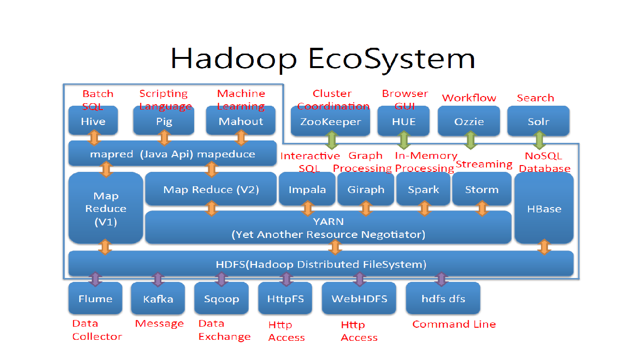
Notes:
Kafka is responsible for message transfer in Hadoop Ecosystem.

Slide 4





Development Background
Abstract
Hadoop: Storage and Backup Mechanism
Kafka: Data Transfer in Application side
Who and When
Kafka was created by LinkedIn (Jay Kneps) at 2010.
Release to Apache at 2011.
Where it operates
Kafka assists over 30% of Fortune 500 Companies.
Notes:
Hadoop is targeted to save large amount of data with safe mechanism, like what we saw in previous page. And Kafka, is responsible for transferring the data between Hadoop backend and user applications in real time. Next, Kafka was created by the company LinkedIn at 2010. With their admirable spirit, they shared the source code of Kafka and released to Apache at 2011. Kafka is such a strong tool that helps over 30% of Fortune 500 Companies to their big-data solutions. For example, like LinkedIn, Netflix, Uber, Walmart and Airbnb.

Slide 5

Development Background
Why & How
Conventional Data Transfer | With the help of Kafka
Need to establish connections between source and target systems. When scaled up, whole system would be too complex to manage. | Make all of the source and target systems connected to Kafka. The system will help us to transfer messages. When scaled up, the system is still easy to manage.
Source1
Source2
Source3
Source4
Source1
Source2
Source3
Source4
Kafka (Black Box)
Target1
Target2
Target3
Target4
Target5
Target1
Target2
Target3
Target4
Target5
$$4×5=20$$
Notes:
Why is Kafka so popular? Now, I’ll explain two kinds of message transfer system. First one is the traditional data transfer system. And we have 4 sources and 5 targets. Our ultimate goal is to transfer the data from any sources to any targets. Therefore, each source must connect to each target and it’ll be built with up to 20 connections because 4 by 5 is equal to 20. You can see that, when the number goes up, this kind of message transfer system would be nearly impossible to maintain. In the other hand, if we got the tool Kafka, as the same situation on the left side, we just need to connect all of the sources and targets to Kafka. Once connected, we don’t even need to know what is inside of Kafka, and the mechanism can be seen as a black box. Even scale grows, what developers should do, is just simply connect the source or target to Kafka. It’s truly beautiful and amazing, isn’t it?

Slide 6
Key Features & Benefits of Kafka
Decoupling: reduce system complexity
Large Scale: more than 100 brokers, million of messages per second
High Performance: latency less than 10ms
Fault Tolerance: generate duplicate partition of data
Maintain the Order of Data: ensure data order in each partition
Resilient: easily recover if encounters any errors
Event Driven: Publisher and Subscriber mechanism
Notes:
Here are the key features of manipulating Kafka, the first one, as I mentioned before, Kafka can greatly reduce system complexity especially when the number of sources and targets goes up. The second one, is that the messages can be transferred in large scale. The third one, even if the data might be large, Kafka can have high performance with latency less than 10 milliseconds. And Fault Tolerance, which means the data sequences can be spread in different locations while transferring. The 5th one, the data can be transferred with desired sequence order in each small chunk of data. Resilient means the errors can be recovered. Next, I’m going to talk about what Event Driven is.

Slide 7
Key Features & Benefits of Kafka
Inefficient!
1ms is a huge load
Message Transfer without Event-Driven Mechanism:
with Event-Driven Mechanism:
Request Temp
Data in Server
Application
Temp Monitor
New Temperature
Retrieve Temp
Efficient!
Get data whenever it changes
Event Driver
Application
Temp Monitor
Subscriber
New Temperature
Publisher
Subscriber
…
Notes:
In a simple and conventional data transfer system, suppose we have an IoT temperature monitor, when the sensor gets the temperature value, it will upload the value to the server. And what the application side will do, is to constantly request and retrieve temperature value, this method is known as “polling”. But now, imagine this temp monitor refreshes data per 1 millisecond. It would cause a huge load to the traffic. So, with the concept of Event-Driven, the application side always be passively informed whenever temperature changes. In event driver, the one would like to emit the signal is called publisher. And the one would like to get the signal is called subscriber. When the temperature changes, the event is generated by the publisher. Then, the publisher will broadcast the signals to all of subscribers connected to it. So, this manner is more efficient to message transfer system without Event-Driven mechanism.

Slide 8
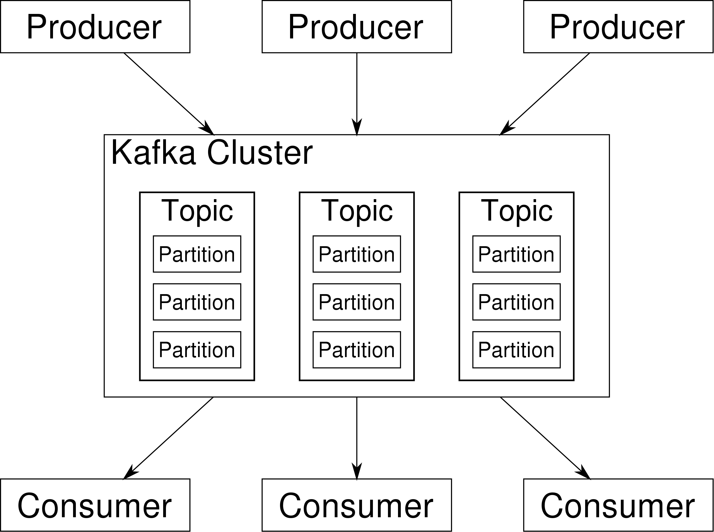
How Kafka Works?
Event-Driven Mechanism
Kafka consists of following APIs:
Producer API
Consumer API
Stream API
Connector API
Event Driver
Application
Temp Monitor
New Temperature
Publisher
Subscriber
Notes:
At the top, is the event-driven mechanism we talked about on the previous page. In Kafka, we have four different APIs, Producer API and Consumer API is corresponding to the publisher and the subscriber on the top picture respectively. Producer generates messages, and consumer receives messages. And the block charges to distribute the messages is called Kafka Cluster. Inside one cluster, there exists numbers of topics. And each topic consists of multiple partitions. So, Kafka Cluster retrieves partitions from the producers, and compile them up to one topic before transferring to Consumer.

Slide 9
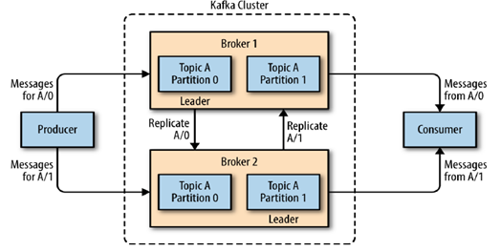
How Kafka Works?
Kafka with Different Brokers
Producer API
Consumer API
Stream API
Connector API
Notes:
The safety mechanism of Kafka is that there are more than one brokers in a cluster. Whenever receives any partitions, the partition would be backed up in different brokers, like this picture. When Broker 1 receives Partition 0 in Topic A, and the broker would copy this partition to Broker 2. And in the same manner, when Broker 2 receives Partition 1 in Topic A, the broker would also copy to Broker 1 before transferring to Consumer.

Slide 10
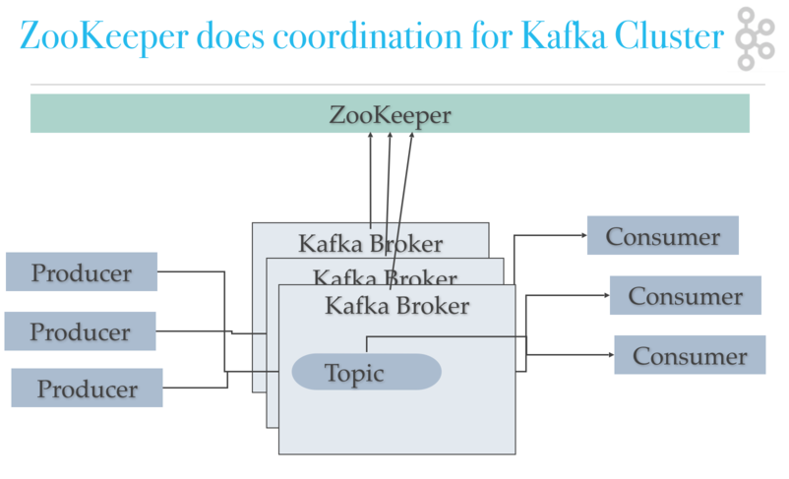
How Kafka Works?
Kafka Clusters Management
Producer API
Consumer API
Stream API
Connector API
Notes:
https://medium.com/@logeesan/zookeeper-in-kafka-ce31b3dd55b1
And in order to manage large number of brokers that might be distributed in different physical data centers, we need ZooKeeper to supervise whether the brokers are working.

Slide 11
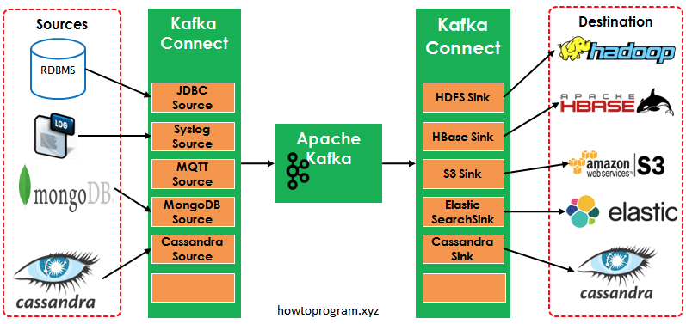
How Kafka Works?
Kafka consists of following APIs:
Producer API
Consumer API
Stream API
Connector API
Kafka Stream
Notes:
https://www.twblogs.net/a/5d12af22bd9eee1e5c823219
https://www.confluent.io/en-gb/blog/hello-world-kafka-connect-kafka-streams/
And if we want to traceback data stream flows through Kafka, we need to implement Stream API. It will generate the log file includes data time stamps of reaching Producer, Broker and Consumer. Connector API is responsible for packaging the whole Kafka system as one module. So, if another application needs to implement this Kafka system, the application can be attached to it easily.

Slide 12
Kafka Use Cases
Messaging: data streaming (LinkedIn, Airbnb, Walmart)
Location Tracking: the car can emit signal event to their server (Uber)
Data Gathering: recommendation to user immediately in responsive website (Netflix real-time while watching TV shows)
Notes:
Applications with Kafka help our everyday lives. Like messaging, location tracking and data gathering. Kafka can transfer all kinds of messages, so it is applied in the social media and E-commerce. And Uber takes the advantages of Kafka which let all drivers’ messages can be sent simultaneously to the server. The audience on Netflix can get the recommendations according to their watching records in real time, make us watch videos one after one.

Slide 13

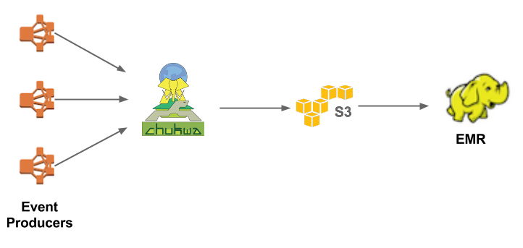
Application Case Study - Netflix
0. Netflix Emerged in Web at 2007
Netflix First Architecture
Notes:
http://highscalability.com/blog/2017/12/11/netflix-what-happens-when-you-press-play.html?currentPage=2
https://www.meritdata-tech.com/resources/blog/digital-engineering-solutions/netflix-apache-kafka-business-intelligence/
https://netflixtechblog.com/kafka-inside-keystone-pipeline-dd5aeabaf6bb
And our case study picked Netflix because of its generosity to share the commercial technology model. A lot of companies would keep their models secret to stay away from potential business competitors. Yep, but Netflix is different. Netflix first emerged in Web at 2007, and they had built 2 data centers in California. But after one-year hard work of moving contents to their data centers, they gave up, because to maintain reliable data centers not only costs lots of money, but needs a lot of mature technologies, and even betrays their only value, which is to provide the video services to the customer. So, in 2008, Netflix moved their contents to Amazon. The picture depicts the first Netflix model, uses Hadoop and Chukwa to provide the contents, which is sufficient at that time. Because they just got to ensure the videos can be distributed to the clients.

Slide 14
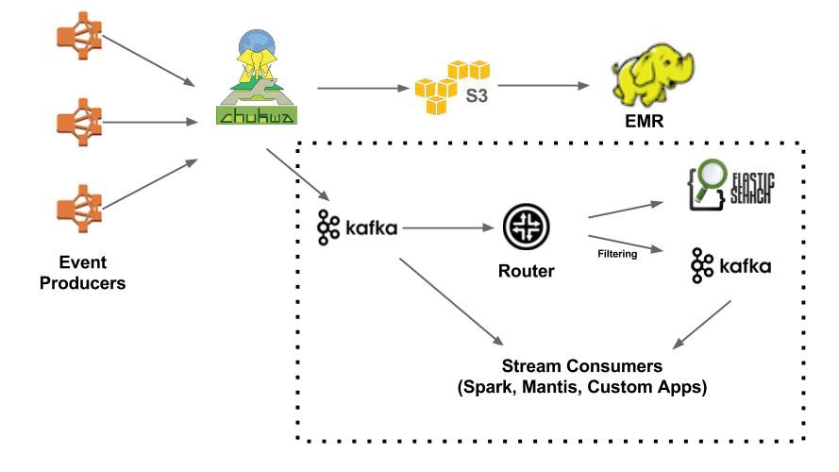
Application Case Study - Netflix
Netflix with Real-time Architecture
Notes:
https://www.meritdata-tech.com/resources/blog/digital-engineering-solutions/netflix-apache-kafka-business-intelligence/
https://netflixtechblog.com/kafka-inside-keystone-pipeline-dd5aeabaf6bb
But after a few years, Netflix wanted to investigate more on the clients and develop the search engine provides the videos to the users that they might be interested in. So, they built the branch of Chukwa to connect to Kafka, the messages can further be processed in Elastic Search or second Kafka in advanced search mode. Kafka also connects to different applications that can do the real-time processing and satisfy users’ demands.

Slide 15
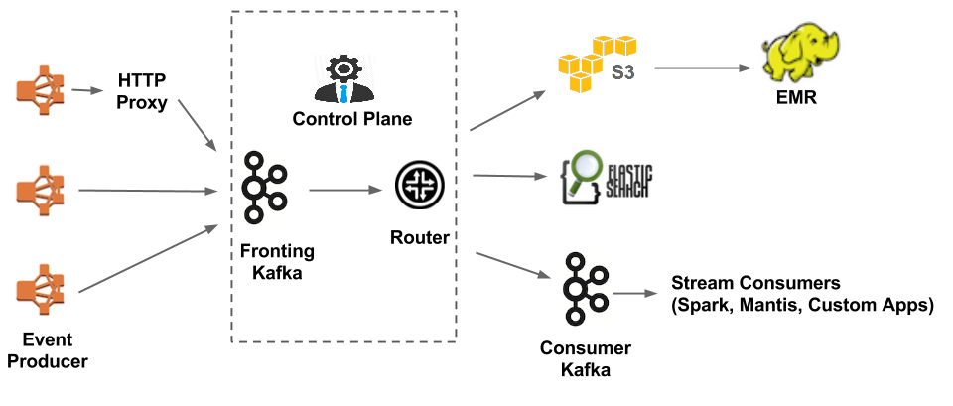
Application Case Study - Netflix
Netflix Current Architecture
Java
Notes:
https://www.meritdata-tech.com/resources/blog/digital-engineering-solutions/netflix-apache-kafka-business-intelligence/
https://netflixtechblog.com/kafka-inside-keystone-pipeline-dd5aeabaf6bb
Because Chukwa doesn’t support replication of data and Netflix wanted to simplify the whole system, Netflix removed Chukwa, and Kafka took place. Make the whole architecture easier to attach to different applications.

Slide 16
Application Case Study - Netflix
Netflix Current Architecture
 | Fronting Kafka Clusters | Consumer Kafka Clusters
Number of Clusters | 24 | 12
Largest Broker No. per Cluster | < 200
Largest Partition No. per Cluster | < 10,000
Replication Factor | 2
Retention Period | 8 to 24 hours |  | 2 to 4 hours
Notes:
https://www.meritdata-tech.com/resources/blog/digital-engineering-solutions/netflix-apache-kafka-business-intelligence/
https://netflixtechblog.com/kafka-inside-keystone-pipeline-dd5aeabaf6bb
Here is the specification of each Kafka in the architecture. Netflix wants to reduce the burden of data loading of each cluster, so they rather increase the number of clusters than the number of brokers or partitions in one cluster. Also make the system easier to manage.

Slide 17


Study Comments
Peak Throughput | 605 MB/s | 38 MB/s
Message Order | Order in each partition | Order for all messages
Reliability | Distributed in different Brokers | Strategic Combination (Process Node Failure)
Data Flow Process | Equipped | None
Latency* | 5 ms (200 MB/s load) | 1 ms (30 MB/s load)
System Dependency | Zookeeper (before v2.8) | None
Language | Scala and Java | Java, Python, Ruby and Erlang
Notes:
Comparison: https://iter01.com/534319.html
Reliability: https://docs.vmware.com/en/VMware-Tanzu-RabbitMQ-for-Kubernetes/1.2/tanzu-rmq/GUID-reliability.html
Our study comments compare Kafka with RabbitMQ, Kafka has significantly greater throughput. Kafka can only order the data in each partition, RabbitMQ can order all of sending messages. Kafka is safer than RabbitMQ, because it has built-in broker message backup mechanism, and in RabbitMQ, developers should tackle the failures themselves. Kafka can set and monitor data flows and has little bit longer latency (but it’s worthy due to reliability). Kafka should operate with Zookeeper in the past, now, it is no need. Therefore, it reminds me what professor said, if you are handling with small data, do not use Hadoop. In this case, Kafka is not the best choice for small message transfer. In the other hand, RabbitMQ can be more flexible and easier to implement.

Slide 18
Summary
Kafka has greatly influenced the world.
Explained the benefits of event-driven message transfer mechanism.
Delve into the architecture of Netflix.
Compare Kafka with RabbitMQ.
Notes:
Finally, the summary to today’s presentation is: the existence of Kafka greatly changes many companies and our lives. Also, we have explained how event-driven system works. And we have introduced the evolution of Netflix architecture. Last, we compare Kafka with RabbitMQ, prove that Kafka is the best choice for large messages transferring.

Slide 19
References
Kafka intro: https://www.youtube.com/watch?v=aj9CDZm0Glc
Kafka in 5 mins: https://www.youtube.com/watch?v=PzPXRmVHMxI
Kafka in LinkedIn: https://www.youtube.com/watch?v=ZrbaXDYUZY8
Kafka in Wiki: https://en.wikipedia.org/wiki/Apache_Kafka
Kafka Connect 簡介: https://www.twblogs.net/a/5d12af22bd9eee1e5c823219
Kafka Connect&Stream: https://www.confluent.io/en-gb/blog/hello-world-kafka-connect-kafka-streams/
Zookeeper in Kafka: https://medium.com/@logeesan/zookeeper-in-kafka-ce31b3dd55b1
What to make Netflix so successful: https://www.meritdata-tech.com/resources/blog/digital-engineering-solutions/netflix-apache-kafka-business-intelligence/

